Slide 1
Rima Alshawkani
VHSA Ambassador 2019
Fairfax County Head Start Policy Council, Treasurer
FCPS Policy Committee
Parent Volunteer

Slide 2
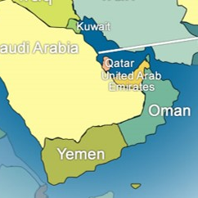
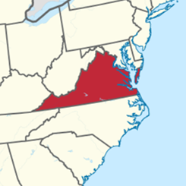
My Story
Yemen
Virginia

Slide 3
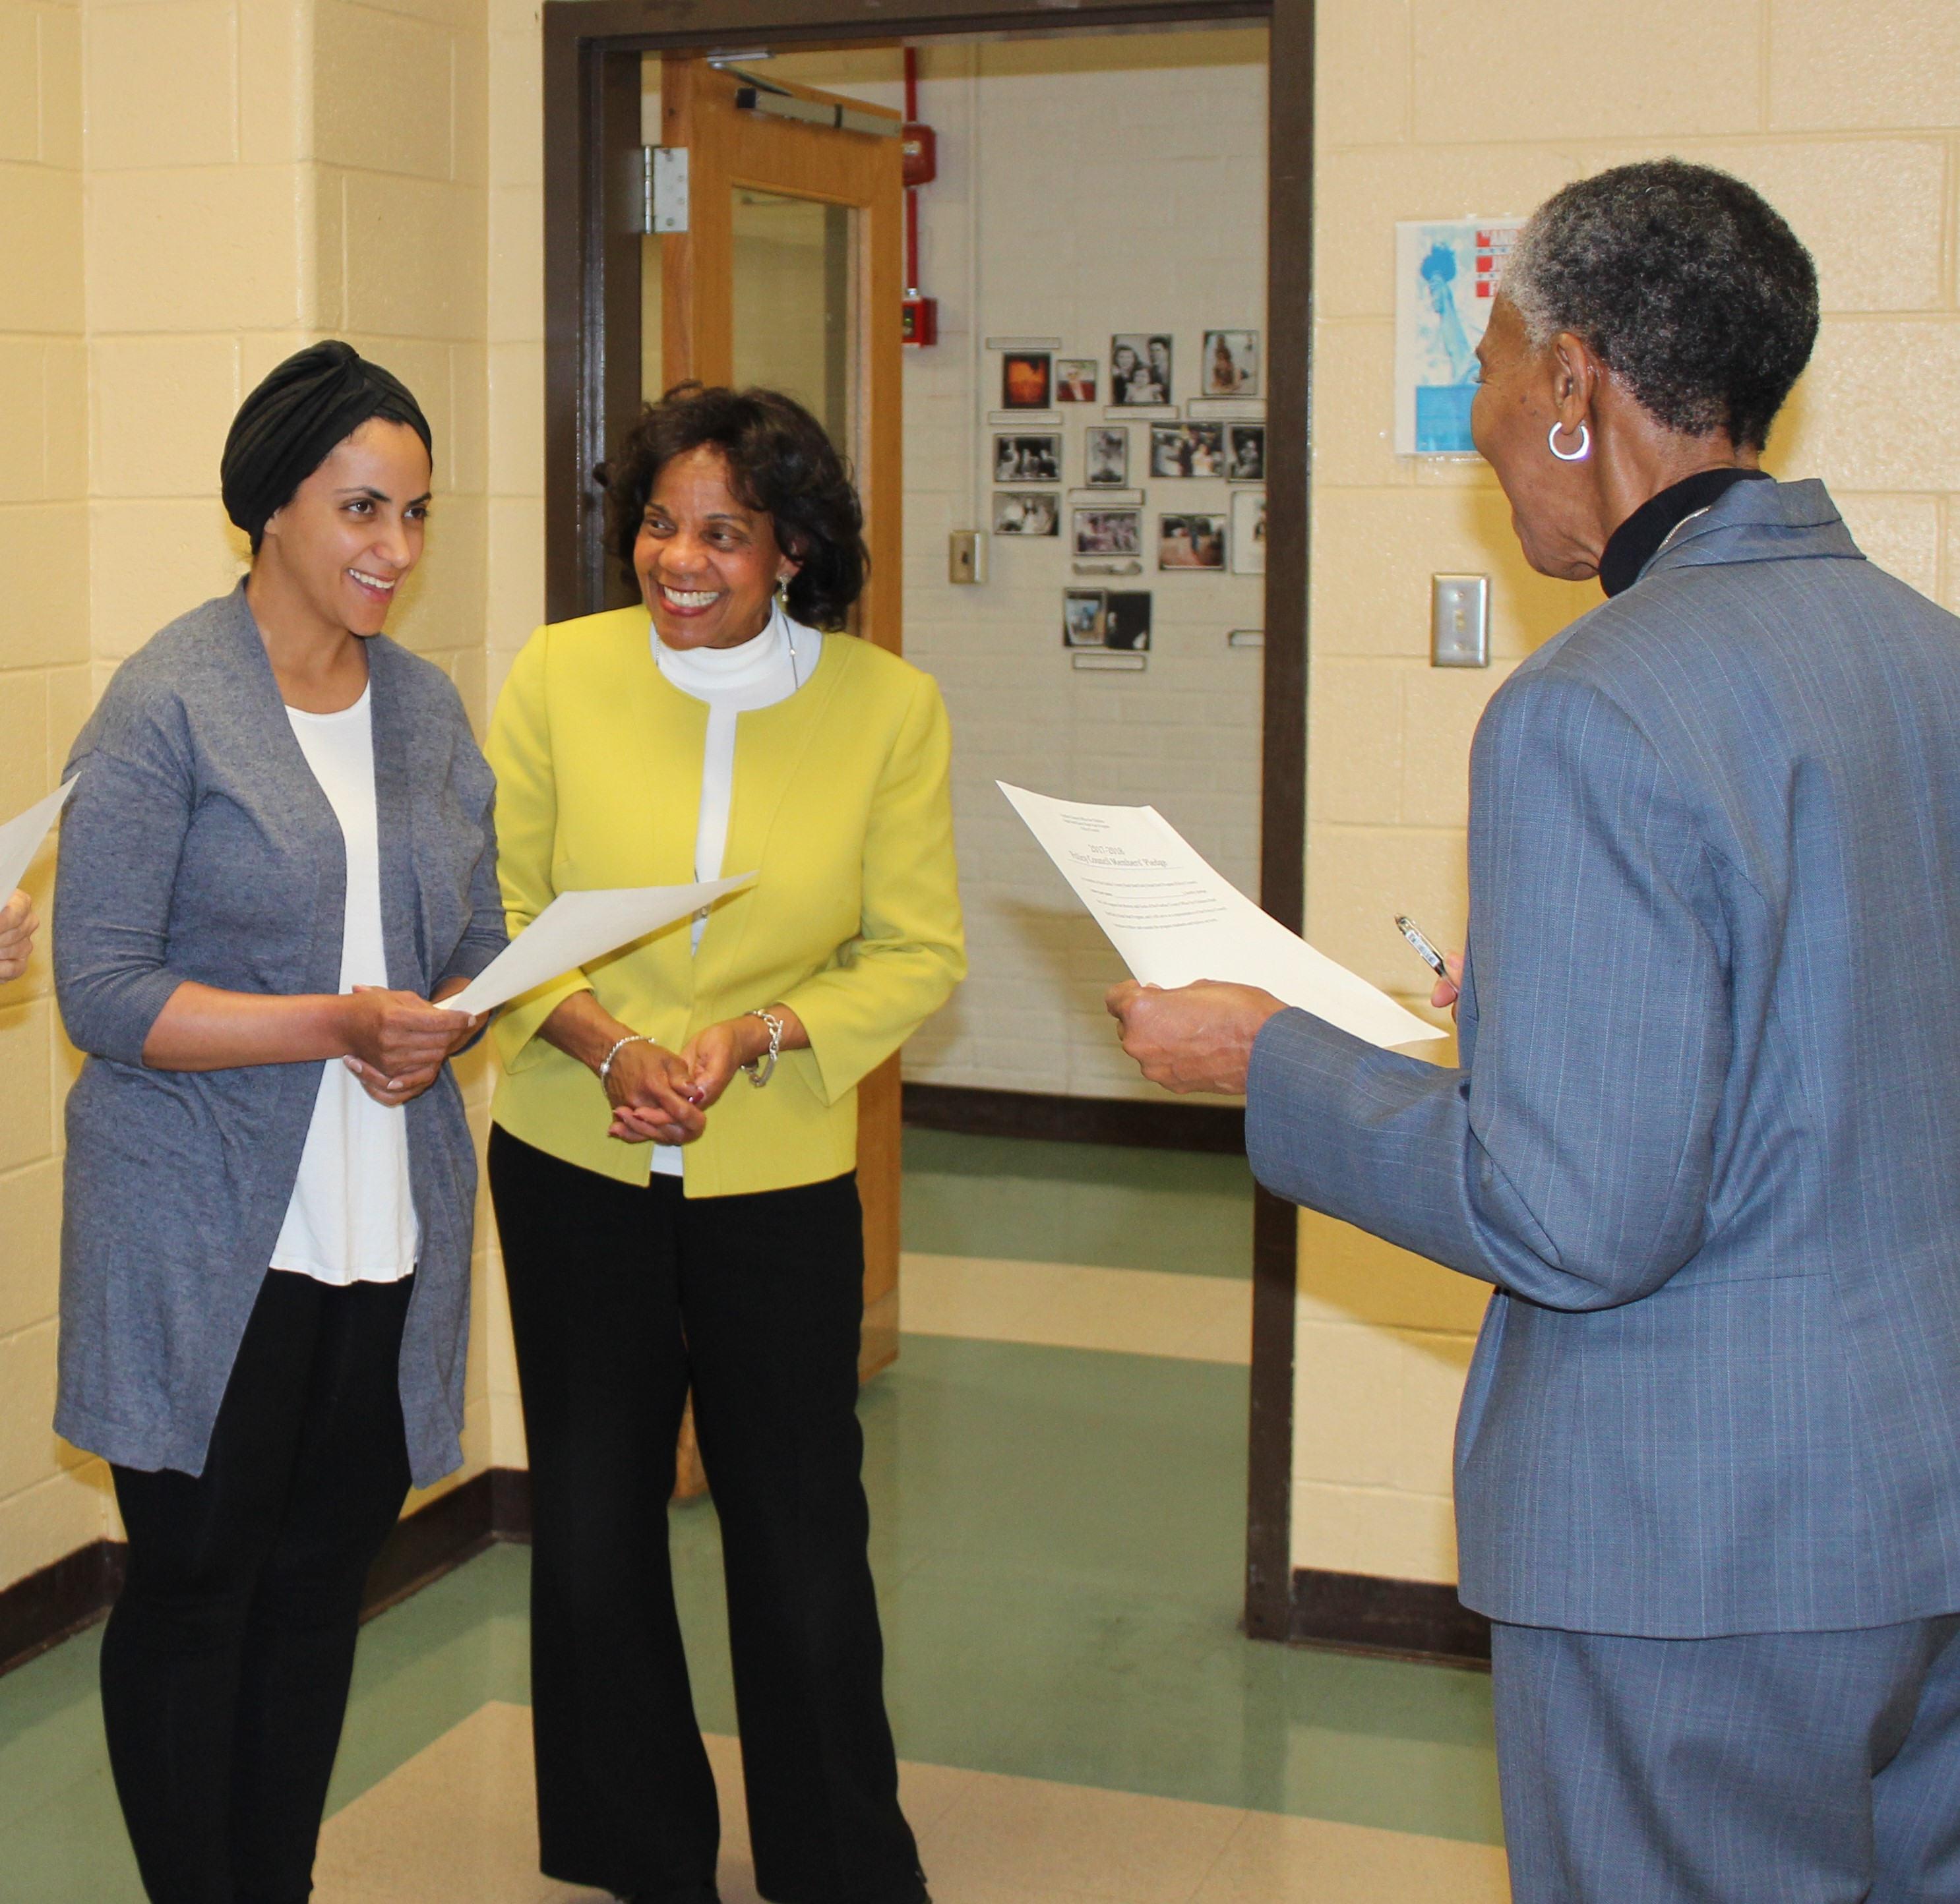
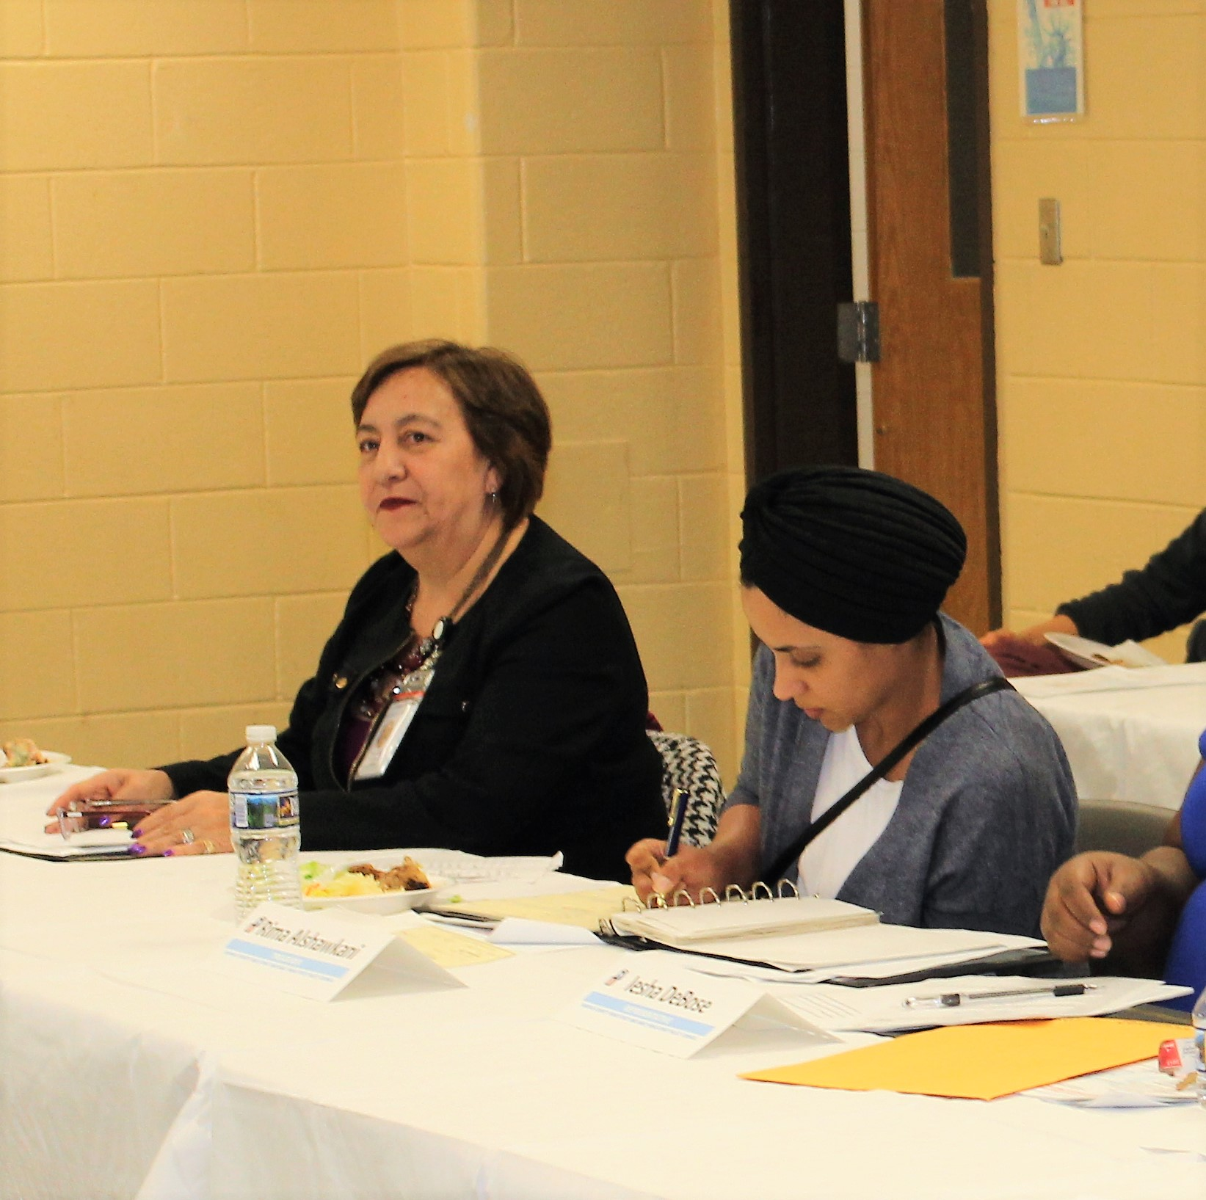
Engagement & Leadership
**add Rima’s photos of herself and children??
Children in Head Start
Policy Committee
Policy Council

Slide 4
Advocacy
Training
Advocacy
Visit to Hill

Slide 5
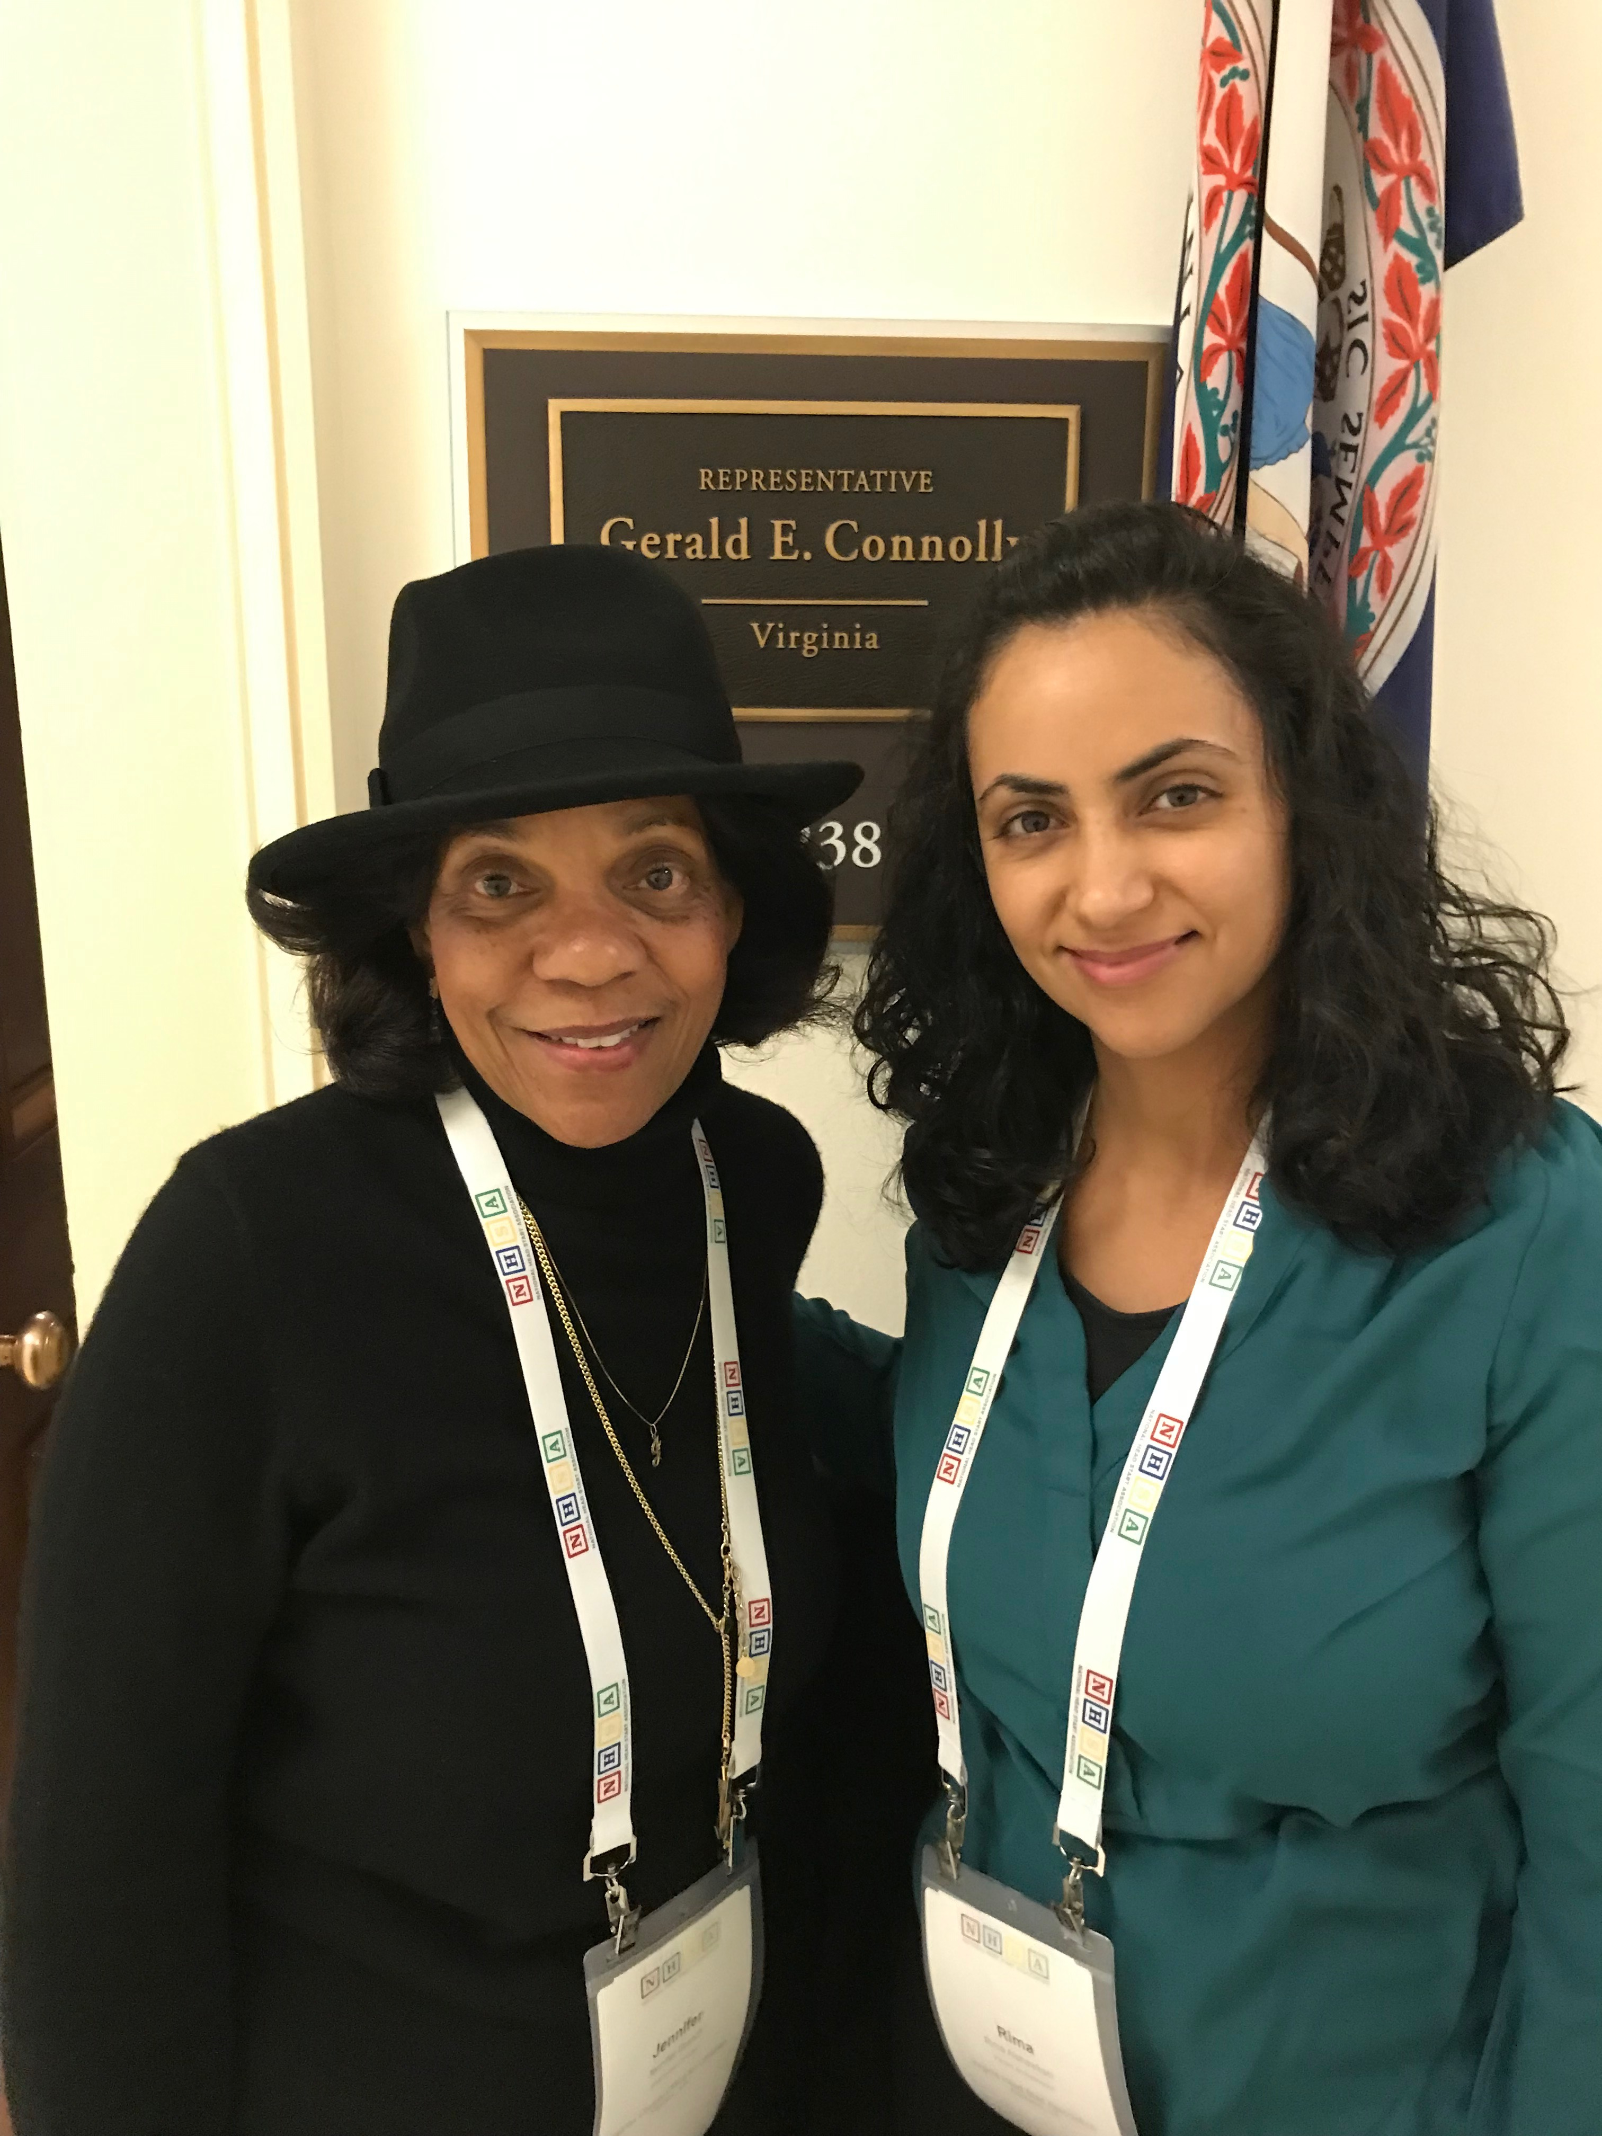
Visit to Capitol Hill

Slide 6
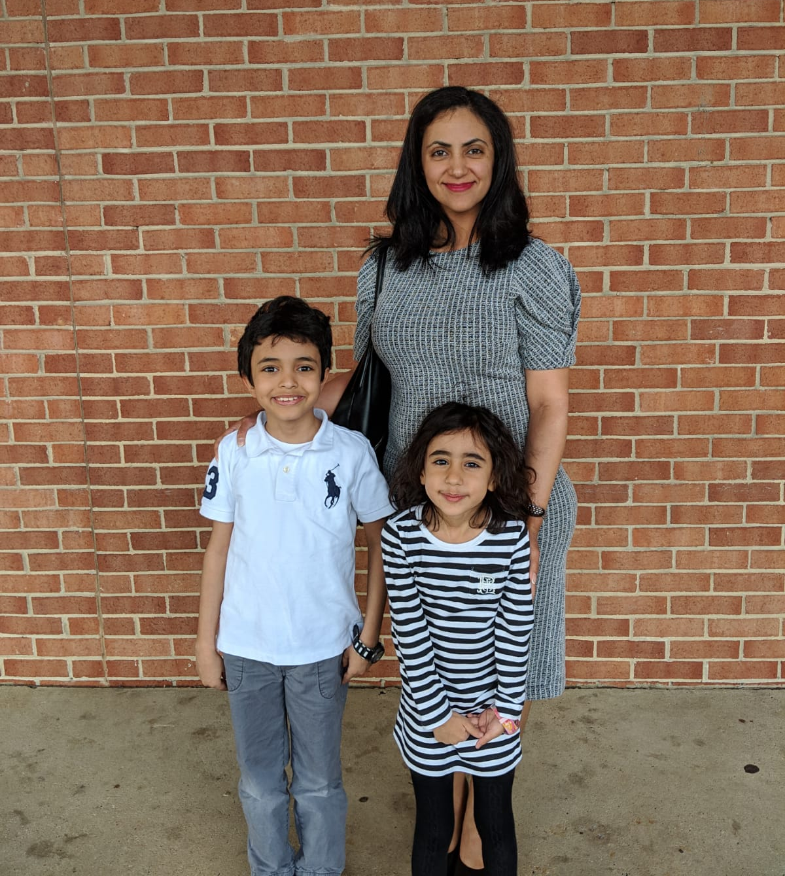
Head Start Works!

Slide 7
Next Steps
Recruitment
Training
Upcoming visit to Capitol Hill, September 2019

